Slide 1




A Complete Guide to Programming in C++
Chapter 9– The Standard Class string

Slide 2


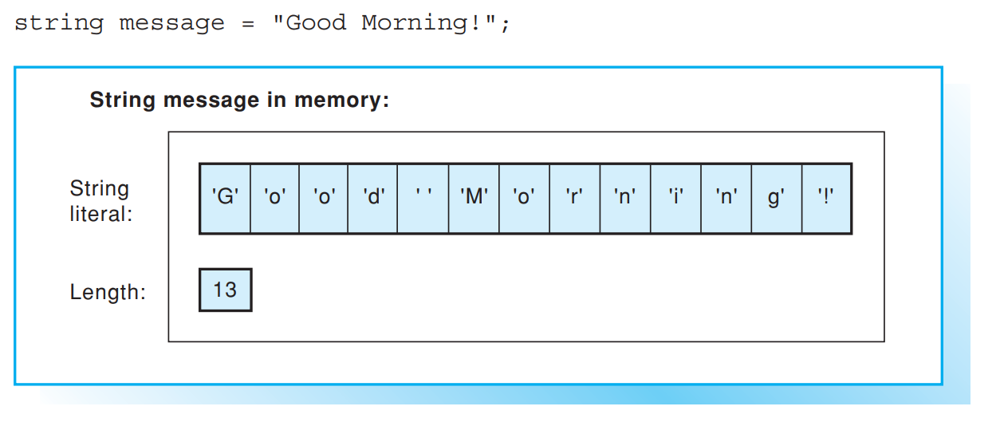
Defining and assigning strings
C++ uses the standard class string to represent and manipulate strings allowing for comfortable and safe string handling. During string operations the required memory space is automatically reserved or modified. The programmer does not need to concern himself or herself with internal memory allocation.
The string class is defined in the string header file and was mentioned in Chapter 3 as an example for the use of classes. Several operators are overloaded for strings, that is, they were also defined for the string class. This allows for easy copying, concatenation, and comparison. Additionally, various methods for string manipulation such as insertion, erasing, searching, and replacing are available.

Slide 3
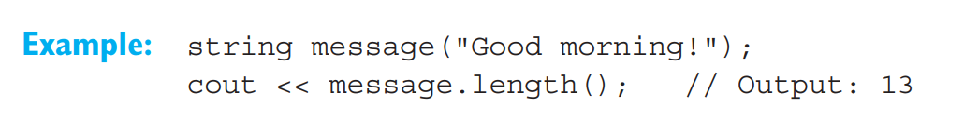
Initializing Strings
A string, that is, an object belonging to the string class, can be initialized when you define it using
a predefined string constant
a certain number of characters
a predefined string or part of a string.
If a string is not initialized explicitly, an empty string with a length of 0 is created. The length of a string, that is, the current number of characters in the string, is stored internally and can be accessed using the length() method or its equivalent size().

Slide 4
String Assignments
When you assign a value to a string, the current contents are replaced by a new character sequence. You can assign the following to a string object:
another string
a string constant
a single character.
The memory space required is adjusted automatically.

Slide 5
Concatenating strings
Within the string class the operators + and += are defined for concatenating, and the operators ==, !=, <, <=, >, and >= are defined for comparing strings. Although these operators are being applied to strings, the well-known rules apply: the + has precedence over the comparative operators, and these in turn have higher precedence than the assignment operators = and +=.

Slide 6
Using + to Concatenate Strings
You can use the + operator to concatenate strings, that is, to join those strings together.
This example concatenates the strings s1 and s2. The result, "sunflower" is then assigned to sum.
Two strings concatenated using the + operator will form an expression of the string type. This expression can in turn be used as an operand in a more complex expression.

Slide 7
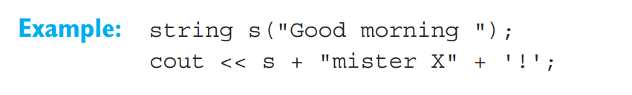
Using + to Concatenate Strings
Since the + operator has precedence over the << operator, the strings are concatenated before the “sum” is output. Concatenation takes place from left to right. String constants and single characters are also valid as operands in expressions containing strings:

Slide 8
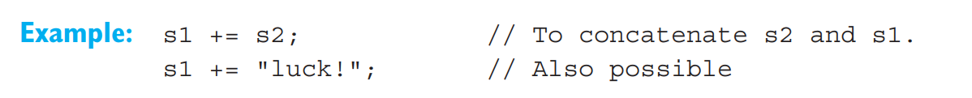
Using += to Concatenate Strings
Strings can also be concatenated by first performing concatenation and then assigning the result.
This example creates a temporary object as a result of s1 + s2 and then assigns the result to s1. However, you can obtain the same result using the assignment operator += , which is far more efficient
This adds the content of the second string directly to s1. Thus, the += operator is preferable to a combination of the + and = operators.
EXAMPLE: Reads several lines of text and outputs in reverse order.

Slide 9
Comparing strings
The comparative operators
==
!=
<
<=
>
>=
were overloaded in the string class to allow easy comparison of strings. This also allows you to use strings to formulate the conditions for branches and loops.

Slide 10
Results of Comparisons
Strings are compared lexicographically, that is character by character, beginning at the first character. To decide whether a single character is smaller, greater, or identical to another character, the character codes of the character set are compared. Thus, if you are using the ASCII character set, the letter 'A' (ASCII code 65) is smaller than the letter 'a' (ASCII code 97).
A comparison results in a bool type value. Given two strings s1 and s2:
s1 == s2 is true only if both strings are identical; this requires that both strings are exactly the same length.
s1 < s2 is true only if the first character in s1 that differs from the corresponding character in s2 is smaller than the corresponding character in s2, or if s2 is simply an extension of s1.
All other comparative operations can be deduced from the above rules. For example, the expression s1 > s2 is true only if s2 < s1 is also true.

Slide 11


Results of Comparisons
In an expression comparing strings, one operand can again be a string constant or a single character.
This example compares the string key with the single character 'y'. This is an alternative method of expressing the comparison key == "y". String comparisons can also be combined to form more complex expressions
The controlling expression is valid if the string key contains only the letter 'Y' or 'y'. Due to the higher precedence of the comparative operator versus the || operator, no parentheses are required in this example

Slide 12

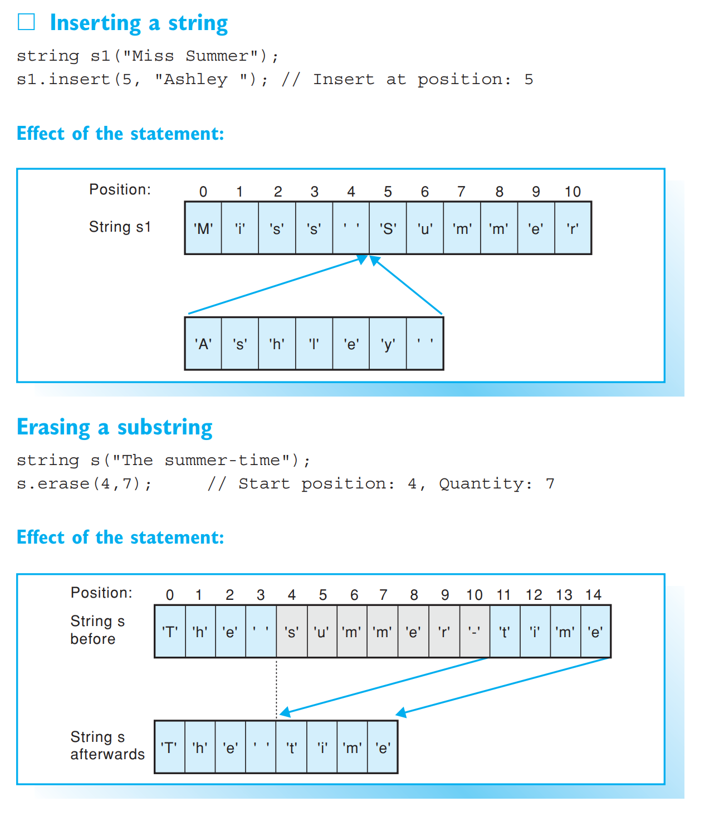
Inserting and Erasing in strings
The string class contains numerous methods for performing string manipulations. A method exists for each operation, such as inserting, erasing, searching, and replacing.
These methods generally allow passing a string constant instead of a second string. A single character can also be used wherever appropriate

Slide 13
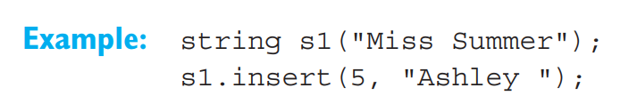
Insertion
The method insert() inserts a string at a certain position of another string. The position is passed as the first argument and defines the character before which to insert the string. The first character in a string occupies position 0, the second character position 1, and so on.
The string "Ashley " is inserted into the string s1 at position 5, that is in front of the 'S' character in "Summer". Following this, the string "Miss Ashley Summer" is assigned to s1. If you need to insert only part of a string into another string, you can pass two additional arguments to the insert() method, the starting position and the length of the string.

Slide 14
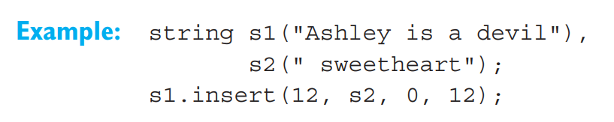
Insertion
This example inserts the first 12 characters from the string s2 at position 13 in string s1. String s1 then contains the string “Ashley is a sweetheart".

Slide 15
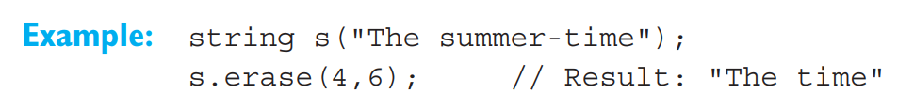
Erasing
You can use the erase() method to delete a given number of characters from a string. The starting position is supplied as the first argument and the number of characters to be erased is the second argument.
This statement deletes 7 characters from string s starting at position 4. The erase() method can also be called without specifying a length and will then delete all the characters in the string up to the end of the string. You can also call erase() without any arguments to delete all the characters in a string

Slide 16
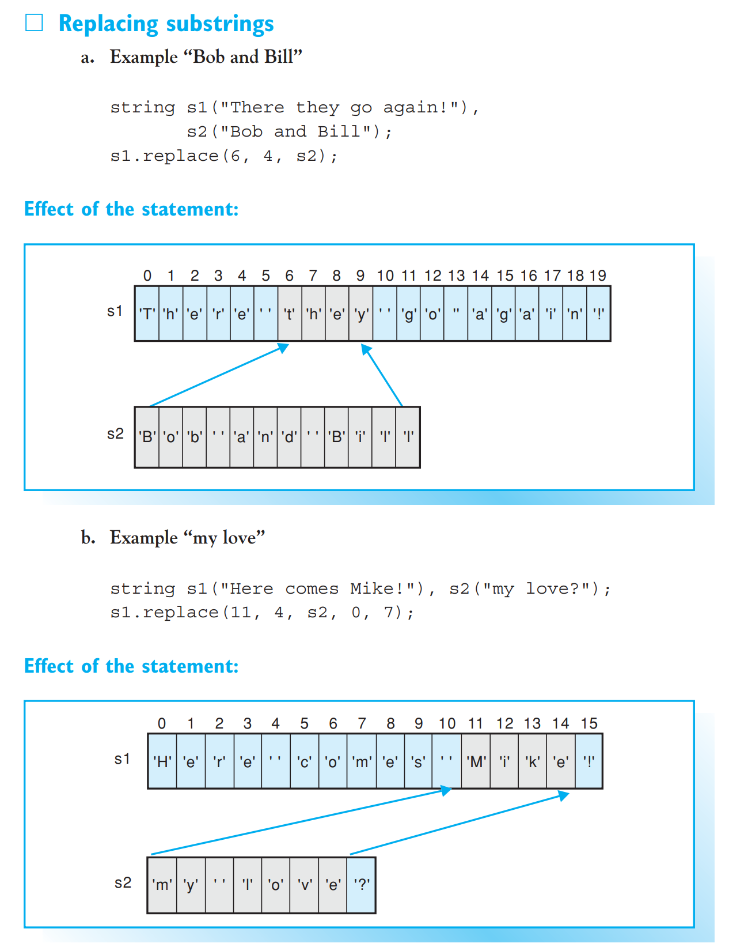
Searching and Replacing in strings

Slide 17
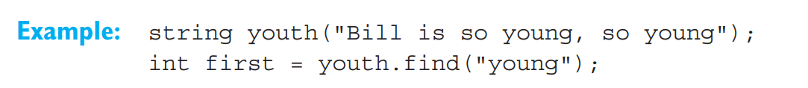
Searching
You can search strings to find the first or last instance of a substring. If the string contains the required substring, the position of the substring found by the search is returned. If not, a pseudo-position npos, or –1, is returned. Since the npos constant is defined in the string class, you can reference it as string::npos.
The find() method returns the position at which a substring was first found in the string. The method requires the substring to be located as an argument.
The variable first has a value of 11 in this example

Slide 18

Searching
You can use the “right find” method rfind() to locate the last occurrence of a substring in a string. This initializes the variable last with a value of 21 in our example.

Slide 19
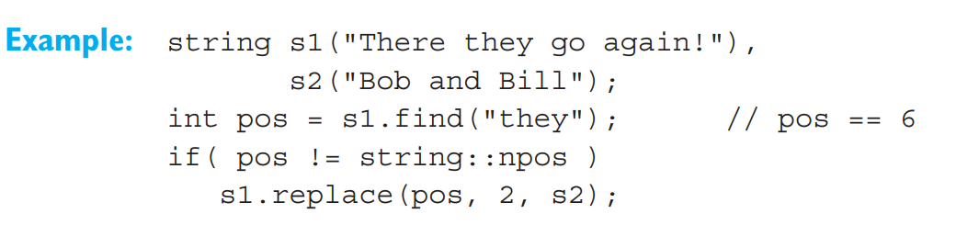
Replacing
When replacing in strings, a string overwrites a substring. The string lengths need not be identical. You can use the replace() method to perform this operation. The first two arguments supply the starting position and the length of the substring to be replaced. The third argument contains the replacement string
This example uses the string s2 to replace 4 characters, "they", starting at position 6 in s1. After this operation s1 contains the string "There Bob and Bill go again!".

Slide 20
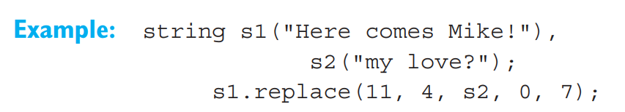
Replacing
If you only need to insert part of a string, you can use the fourth argument to define the starting position and the fifth to define the length of the substring.
The string s1 is changed to "Here comes my love!".

Slide 21
Accessing characters in strings
When manipulating strings it is often important to access the individual characters that form the string. C++ has the operator [] and the method at() for this purpose. An individual character is always identified by its index, also referred to as subscript, that is, its position in the string. The first character will always have an index value of 0, the second an index of 1, and so on.

Slide 22
Subscript operator
The easiest way to access a single character in the string is to use the subscript operator []. If you define a string as follows, Example: string s = "Let"; the individual characters in the string are: s[0] == 'L', s[1] == 'e', s[2] == 't'
The last character in a string always has an index of s.length() – 1. You can use the subscript operator to read any character in a string and also to overwrite a character, provided the string was not defined as a constant.
Example: char c = s[0]; This statement copies the first character from s to the variable c. In contrast Example: s[s.length() –1] = 'g'; overwrites the last character in the string s. Following this, s will contain the string "Leg".

Slide 23

Invalid indices
Any integral expression can be used as an index. However, no error message occurs if the boundaries of a valid index are overstepped.
Your program’s reaction to an invalid index is undefined; this requires careful attention by the programmer! You can call the at() method if you need to perform range checks.

Slide 24
The at() method
You can also use the at()method to access a single character
In contrast to the subscript operator, the at() method performs range checking. If an invalid index is found an exception occurs and the program will normally be terminated at this point. However, you can specify how a program should react to an exception
EXAMPLE: The program counts words and white space characters. (A word is the maximum sequence of characters containing no white space characters.)

